Slide 1
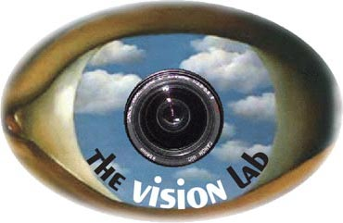

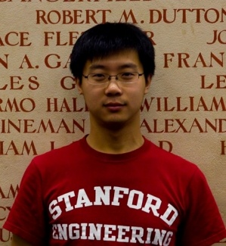

Modeling Mutual Context of Object and Human Pose in Human-Object Interaction Activities
Bangpeng Yao and Li Fei-Fei
Computer Science Department, Stanford University
{bangpeng,feifeili}@cs.stanford.edu

Slide 2
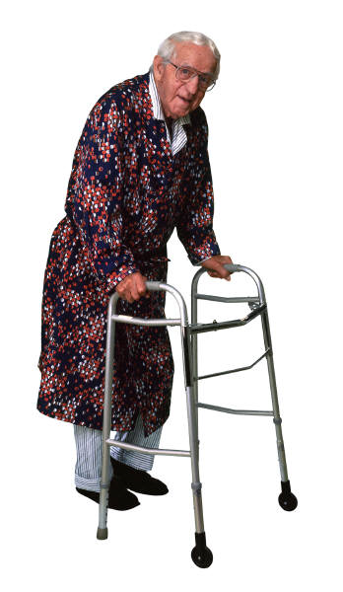
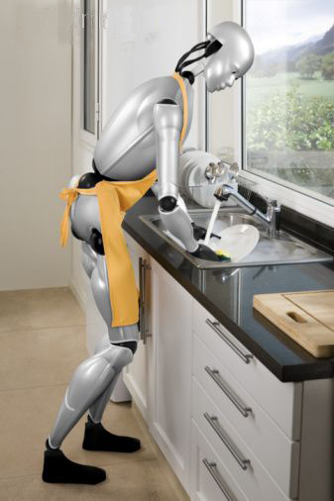
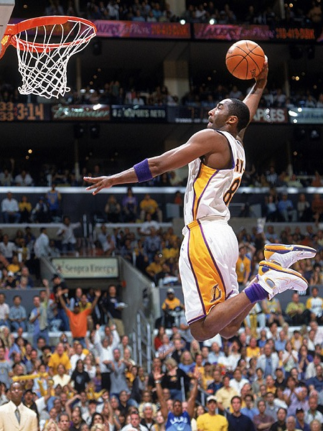
Human-Object Interaction
Robots interact with objects
Automatic sports commentary
Medical care
“Kobe is dunking the ball.”

Slide 3
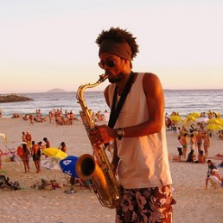
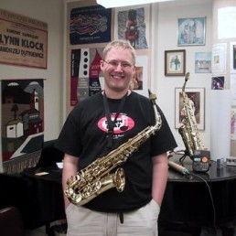
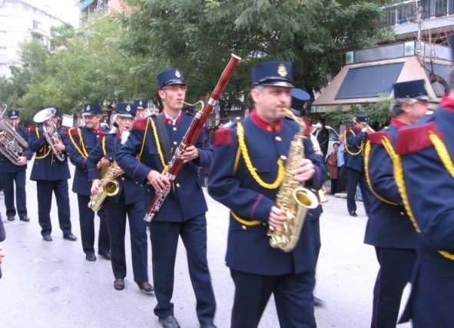
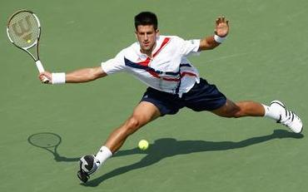
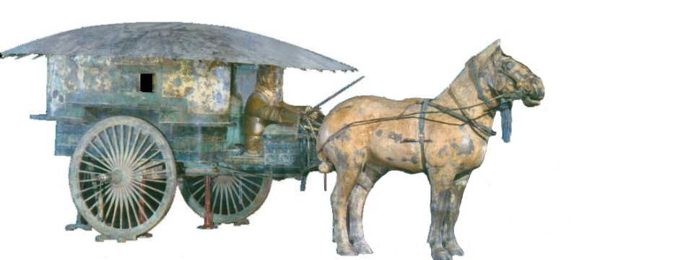
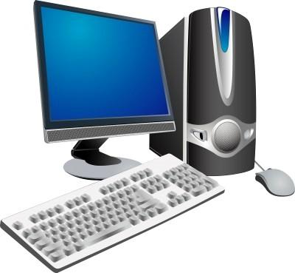
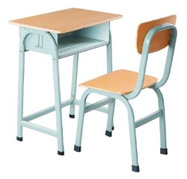
Human-Object Interaction
Holistic image based classification
(Previous talk: Grouplet)
Playing bassoon
Playing saxophone
Detailed understanding and reasoning
Playing saxophone
Vs.
Grouplet is a generic feature for structured objects, or interactions of groups of objects.
HOI activity: Tennis Forehand
Caltech101
Berg & Malik, 2005 | Grauman & Darrell, 2005 | Gehler & Nowozin, 2009 | OURS
48% | 59% | 77% | 62%

Slide 4
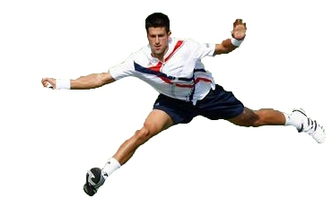
Human-Object Interaction
Holistic image based classification
Detailed understanding and reasoning
Human pose estimation
Head
Right-arm
Left-arm
Torso
Right-leg
Left-leg

Slide 5

Human-Object Interaction
Holistic image based classification
Detailed understanding and reasoning
Human pose estimation
Object detection
Tennis racket

Slide 6
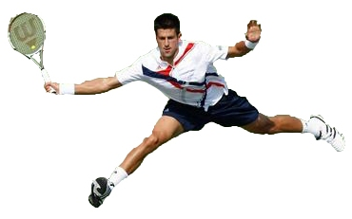
Human-Object Interaction
Holistic image based classification
Detailed understanding and reasoning
Human pose estimation
Object detection
Head
Right-arm
Left-arm
Tennis racket
Torso
Right-leg
Left-leg
HOI activity: Tennis Forehand

Slide 7
Outline
Background and Intuition
Mutual Context of Object and Human Pose
Model Representation
Model Learning
Model Inference
Experiments
Conclusion

Slide 8
Outline
Background and Intuition
Mutual Context of Object and Human Pose
Model Representation
Model Learning
Model Inference
Experiments
Conclusion

Slide 9
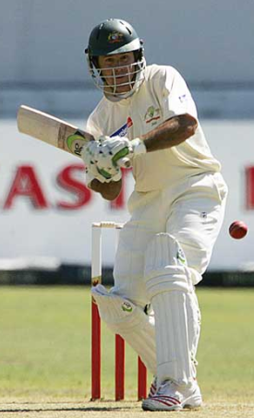
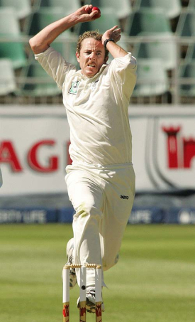
Human pose estimation & Object detection
Human pose estimation is challenging.
Difficult part appearance
Self-occlusion
Image region looks like a body part
Felzenszwalb & Huttenlocher, 2005
Ren et al, 2005
Ramanan, 2006
Ferrari et al, 2008
Yang & Mori, 2008
Andriluka et al, 2009
Eichner & Ferrari, 2009

Slide 10
Human pose estimation & Object detection
Human pose estimation is challenging.
Felzenszwalb & Huttenlocher, 2005
Ren et al, 2005
Ramanan, 2006
Ferrari et al, 2008
Yang & Mori, 2008
Andriluka et al, 2009
Eichner & Ferrari, 2009

Slide 11
Human pose estimation & Object detection
Facilitate
Given the object is detected.

Slide 12
Human pose estimation & Object detection
Object detection is challenging
Small, low-resolution, partially occluded
Image region similar to detection target
Viola & Jones, 2001
Lampert et al, 2008
Divvala et al, 2009
Vedaldi et al, 2009

Slide 13
Human pose estimation & Object detection
Object detection is challenging
Viola & Jones, 2001
Lampert et al, 2008
Divvala et al, 2009
Vedaldi et al, 2009

Slide 14
Human pose estimation & Object detection
Facilitate
Given the pose is estimated.

Slide 15

Human pose estimation & Object detection
Mutual Context

Slide 16
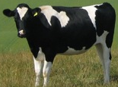
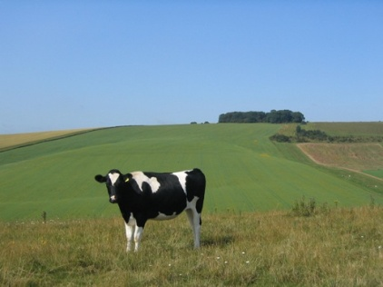

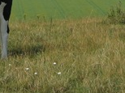
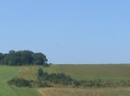
Context in Computer Vision
Previous work – Use context cues to facilitate object detection:
Helpful, but only moderately outperform better
~3-4%
with context
without context
Hoiem et al, 2006
Rabinovich et al, 2007
Oliva & Torralba, 2007
Heitz & Koller, 2008
Desai et al, 2009
Divvala et al, 2009
Murphy et al, 2003
Shotton et al, 2006
Harzallah et al, 2009
Li, Socher & Fei-Fei, 2009
Marszalek et al, 2009
Bao & Savarese, 2010
Viola & Jones, 2001
Lampert et al, 2008

Slide 17
Context in Computer Vision
Previous work – Use context cues to facilitate object detection:
Our approach – Two challenging tasks serve as mutual context of each other:
With mutual context:
Helpful, but only moderately outperform better
~3-4%
Without context:
with context
without context
Hoiem et al, 2006
Rabinovich et al, 2007
Oliva & Torralba, 2007
Heitz & Koller, 2008
Desai et al, 2009
Divvala et al, 2009
Murphy et al, 2003
Shotton et al, 2006
Harzallah et al, 2009
Li, Socher & Fei-Fei, 2009
Marszalek et al, 2009
Bao & Savarese, 2010

Slide 18
Outline
Background and Intuition
Mutual Context of Object and Human Pose
Model Representation
Model Learning
Model Inference
Experiments
Conclusion

Slide 19
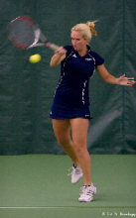
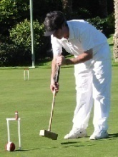
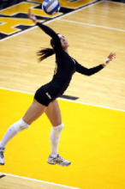
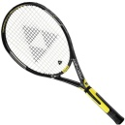
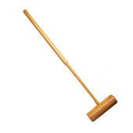
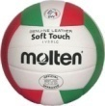

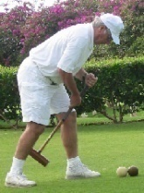
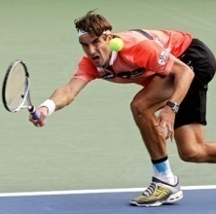
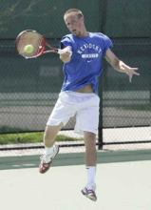
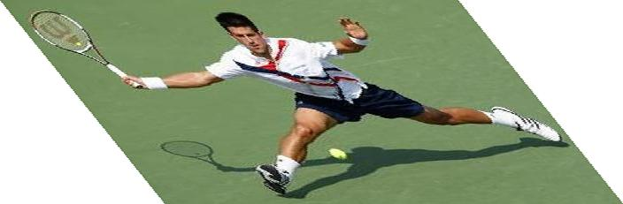
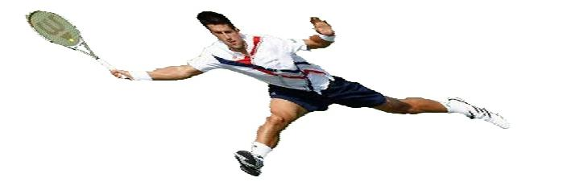
Mutual Context Model Representation
A:
Activity
A
Tennis forehand
Croquet shot
Volleyball smash
Human pose
H
O:
Object
O
Tennis racket
Croquet mallet
Volleyball
Body parts
P₁
P₂
P_{N}
H:
f_{O}
f₁
f₂
f_{N}
Intra-class variations
More than one H for each A;
Unobserved during training.
Image evidence
P:
l_{P}: location; θ_{P}: orientation; s_{P}: scale.
f:
Shape context.
[Belongie et al, 2002]

Slide 20
Mutual Context Model Representation
Markov Random Field
, , : Frequency of co-occurrence between A, O, and H.
A
Clique weight
Clique potential
H
O
P₁
P₂
P_{N}
f_{O}
f₁
f₂
f_{N}

Slide 21
Mutual Context Model Representation
Markov Random Field
, , : Frequency of co-occurrence between A, O, and H.
A
, , : Spatial relationship among object and body parts.
Clique weight
Clique potential
H
O
location
orientation
size
P₁
P₂
P_{N}
f_{O}
f₁
f₂
f_{N}

Slide 22
Mutual Context Model Representation
Markov Random Field
, , : Frequency of co-occurrence between A, O, and H.
A
, , : Spatial relationship among object and body parts.
Clique weight
Clique potential
H
O
Obtained by structure learning
location
orientation
size
Learn structural connectivity among the body parts and the object.
P₁
P₂
P_{N}
f_{O}
f₁
f₂
f_{N}

Slide 23
Mutual Context Model Representation
Markov Random Field
, , : Frequency of co-occurrence between A, O, and H.
A
, , : Spatial relationship among object and body parts.
Clique weight
Clique potential
H
O
location
orientation
size
Learn structural connectivity among the body parts and the object.
P₁
P₂
P_{N}
f_{O}
and : Discriminative part detection scores.
f₁
f₂
f_{N}
Shape context + AdaBoost
[Andriluka et al, 2009]
[Belongie et al, 2002]
[Viola & Jones, 2001]

Slide 24
Outline
Background and Intuition
Mutual Context of Object and Human Pose
Model Representation
Model Learning
Model Inference
Experiments
Conclusion

Slide 25


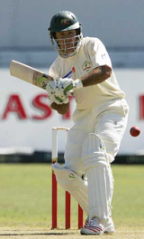

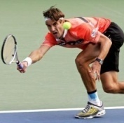

Model Learning
A
Input:
H
O
cricket shot
cricket bowling
P₁
P₂
P_{N}
f_{O}
f₁
f₂
f_{N}
Goals:
Hidden human poses

Slide 26
Model Learning
A
Input:
H
O
cricket shot
cricket bowling
P₁
P₂
P_{N}
f_{O}
f₁
f₂
f_{N}
Goals:
Hidden human poses
Structural connectivity

Slide 27
Model Learning
A
Input:
H
O
cricket shot
cricket bowling
P₁
P₂
P_{N}
f_{O}
f₁
f₂
f_{N}
Goals:
Hidden human poses
Structural connectivity
Potential parameters
Potential weights

Slide 28
Model Learning
A
Input:
H
O
cricket shot
cricket bowling
P₁
P₂
P_{N}
f_{O}
f₁
f₂
f_{N}
Goals:
Hidden human poses
Hidden variables
Structural connectivity
Structure learning
Potential parameters
Parameter estimation
Potential weights

Slide 29
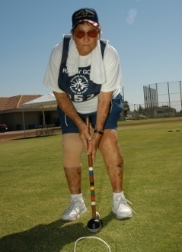


Model Learning
A
Approach:
H
croquet shot
O
P₁
P₂
P_{N}
f_{O}
f₁
f₂
f_{N}
Goals:
Hidden human poses
Structural connectivity
Potential parameters
Potential weights

Slide 30
Model Learning
A
Approach:
H
Hill-climbing
O
Joint density of the model
Gaussian priori of the edge number
P₁
P₂
P_{N}
f_{O}
f₁
f₂
f_{N}
Add an edge
Remove an edge
Goals:
Hidden human poses
Structural connectivity
Potential parameters
Add an edge
Remove an edge
Potential weights

Slide 31
Model Learning
A
Approach:
H
Maximum likelihood
O
P₁
P₂
P_{N}
f_{O}
Standard AdaBoost
f₁
f₂
f_{N}
Goals:
Hidden human poses
Structural connectivity
Potential parameters
Potential weights

Slide 32
Model Learning
A
Approach:
H
Max-margin learning
O
P₁
P₂
P_{N}
f_{O}
f₁
f₂
f_{N}
Goals:
Hidden human poses
Notations
Structural connectivity
x_{i}: Potential values of the i-th image.
w_{r}: Potential weights of the r-th pose.
y(r): Activity of the r-th pose.
ξ_{i}: A slack variable for the i-th image.
Potential parameters
Potential weights

Slide 33
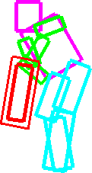
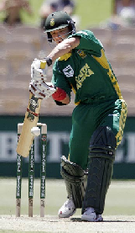
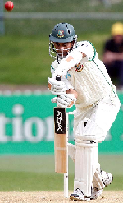

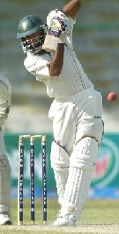
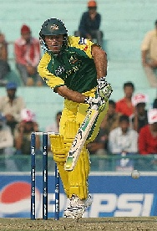

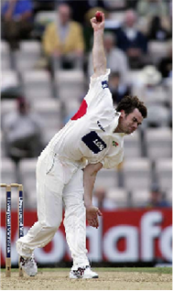
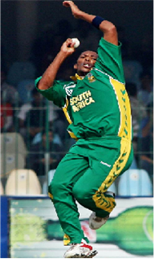
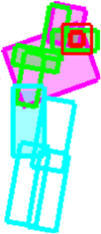
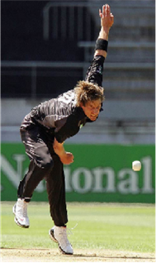
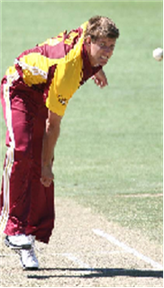
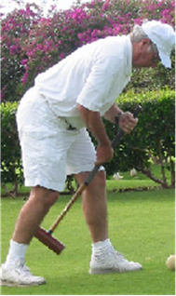
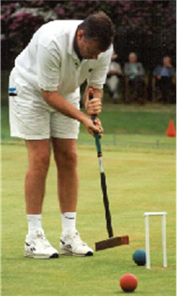

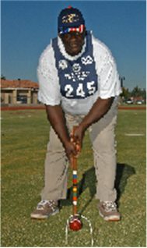
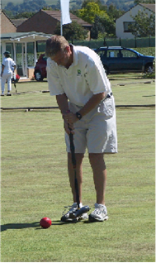
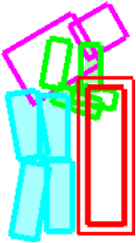
Learning Results
Cricket defensive shot
Cricket bowling
Croquet shot

Slide 34
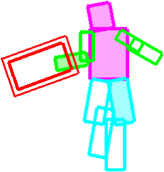

















Learning Results
Tennis forehand
Tennis serve
Volleyball smash

Slide 35
Outline
Background and Intuition
Mutual Context of Object and Human Pose
Model Representation
Model Learning
Model Inference
Experiments
Conclusion

Slide 36




Model Inference
The learned models

Slide 37



Model Inference
The learned models
Head detection
Torso detection
Compositional Inference
[Chen et al, 2007]
Tennis racket detection
Layout of the object and body parts.

Slide 38
Model Inference
The learned models
Output

Slide 39
Outline
Background and Intuition
Mutual Context of Object and Human Pose
Model Representation
Model Learning
Model Inference
Experiments
Conclusion

Slide 40






Dataset and Experiment Setup
Sport data set: 6 classes
180 training (supervised with object and part locations) & 120 testing images
Tasks:
Object detection;
Pose estimation;
Activity classification.
Cricket defensive shot
Cricket bowling
Croquet shot
Tennis forehand
Tennis serve
Volleyball smash
[Gupta et al, 2009]

Slide 41
Dataset and Experiment Setup
Sport data set: 6 classes
180 training (supervised with object and part locations) & 120 testing images
Tasks:
Object detection;
Pose estimation;
Activity classification.
Cricket defensive shot
Cricket bowling
Croquet shot
Tennis forehand
Tennis serve
Volleyball smash
[Gupta et al, 2009]

Slide 42









Object Detection Results
Cricket bat
Cricket ball
Valid region
Sliding window
Pedestrian context
Our Method
[Andriluka et al, 2009]
[Dalal & Triggs, 2006]
Croquet mallet
Tennis racket
Volleyball
42

Slide 43






Object Detection Results
Sliding window
Pedestrian context
Our method
Cricket ball
Small object
Volleyball
Background clutter
43

Slide 44
Dataset and Experiment Setup
Sport data set: 6 classes
180 training & 120 testing images
Tasks:
Object detection;
Pose estimation;
Activity classification.
Cricket defensive shot
Cricket bowling
Croquet shot
Tennis forehand
Tennis serve
Volleyball smash
[Gupta et al, 2009]

Slide 45
Human Pose Estimation Results
Method | Torso | Upper Leg |  | Lower Leg |  | Upper Arm |  | Lower Arm |  | Head
Ramanan, 2006 | .52 | .22 | .22 | .21 | .28 | .24 | .28 | .17 | .14 | .42
Andriluka et al, 2009 | .50 | .31 | .30 | .31 | .27 | .18 | .19 | .11 | .11 | .45
Our full model | .66 | .43 | .39 | .44 | .34 | .44 | .40 | .27 | .29 | .58

Slide 46




Human Pose Estimation Results
Method | Torso | Upper Leg |  | Lower Leg |  | Upper Arm |  | Lower Arm |  | Head
Ramanan, 2006 | .52 | .22 | .22 | .21 | .28 | .24 | .28 | .17 | .14 | .42
Andriluka et al, 2009 | .50 | .31 | .30 | .31 | .27 | .18 | .19 | .11 | .11 | .45
Our full model | .66 | .43 | .39 | .44 | .34 | .44 | .40 | .27 | .29 | .58
Tennis serve model
Our estimation result
Andriluka et al, 2009
Volleyball smash model
Our estimation result
Andriluka et al, 2009

Slide 47






Human Pose Estimation Results
Method | Torso | Upper Leg |  | Lower Leg |  | Upper Arm |  | Lower Arm |  | Head
Ramanan, 2006 | .52 | .22 | .22 | .21 | .28 | .24 | .28 | .17 | .14 | .42
Andriluka et al, 2009 | .50 | .31 | .30 | .31 | .27 | .18 | .19 | .11 | .11 | .45
Our full model | .66 | .43 | .39 | .44 | .34 | .44 | .40 | .27 | .29 | .58
One pose per class | .63 | .40 | .36 | .41 | .31 | .38 | .35 | .21 | .23 | .52
Estimation result
Estimation result
Estimation result
Estimation result

Slide 48
Dataset and Experiment Setup
Sport data set: 6 classes
180 training & 120 testing images
Tasks:
Object detection;
Pose estimation;
Activity classification.
Cricket defensive shot
Cricket bowling
Croquet shot
Tennis forehand
Tennis serve
Volleyball smash
[Gupta et al, 2009]

Slide 49










Activity Classification Results
No scene information
Scene is critical!!
Cricket shot
Tennis forehand
Our model
Gupta et al, 2009
Bag-of-words
SIFT+SVM

Slide 50




Conclusion
Grouplet representation
Human-Object Interaction
Vs.
Mutual context model
Next Steps
Pose estimation & Object detection on PPMI images.
Modeling multiple objects and humans.

Slide 51

Acknowledgment
Stanford Vision Lab reviewers:
Barry Chai (1985-2010)
Juan Carlos Niebles
Hao Su
Silvio Savarese, U. Michigan
Anonymous reviewers

